Slide 1
Datasheets and Coding with Style
EEOB590A
Haldre Rogers
Fall 2021

Slide 2
GitHub- Course Materials
Start every class by opening “course materials” and ”Pulling” all new files down.
You will never push changes on this Course Materials repo back to GitHub.
If you made changes to any files, you can save them with a new name, and put them on your ‘git.ignore’ list so they don’t get tracked.
End every class by closing the Course Materials project.

Slide 3
GitHub - Individual Projects
Each of you should have your individual projects in GitHub now.
Add your homework assignments to the 590A folder
You should replace existing files in the folders with your own data, protocol etc. files.

Slide 4
Outline
Make great datasheets
Make a tidy database
Code with style

Slide 5
1. Designing good datasheets
Two datasheets in Course Materials folder or handed out during class
Look at these sample datasheets
What is good about it?
What would you change?

Slide 6
1. Designing good datasheets
Header information – reduces repetition/empty space
Organization - what does a row mean?
"Column variable, row observation"
Units of measurement clearly demarcated on datasheet
Use consistent codes (guide to codes at bottom)
Enough space to record data clearly
Room for notes
Page numbers (page __ of __)
Boxes for “entered, proofed, scanned”

Slide 7
2. Make a tidy database
Look at these sample databases
What is good about each?
What would you change?
Now make your own “untidy” database. Add every annoying thing you’ve ever seen in a database structure.

Slide 8
2. Use the tidy format for your database
Hadley Wickham's Tidy Data
In tidy data:
Each variable forms a column.
Each observation forms a row.
Each type of observational unit forms a table.

Slide 9
2. Make a database ready for R
Name columns with R in mind (avoid all punctuation/symbols/spaces)
Use consistent names/codes (if Excel, consider data validation)
Case matters in R (upper vs lower), so pick one
Store with appropriate date/time formats (R default is YYYY-MM-DD)
Identify missing values and define missing value codes; make sure true zeros are distinguished from missing data.
Use R-safe delimiters (avoid commas within a cell, symbols)
Avoid using delimiters that also occur in the data fields or avoid putting delimiters in data field.
If this cannot be avoided, enclose data fields that also contain a delimiter in single or double quotes.

Slide 10
2. Make a database ready for R, continued
Do not calculate new values from measured data in Excel. Do that in R.
Identify estimated data (should not be entered in a manner identical to measured data)
Separate data from notes
Do not fill cells with colors that are meaningful
Do not skip lines

Slide 11
Exercise
Open up your own database
What would you change in your database?
Can you make those changes in R?

Slide 12
3. Code with style
Style is important so YOU and OTHERS can read your code and actually use it
Tidyverse Style Guide
Hadley Wickham's style guide
Google style guide
Condensed version of Google/Hadley guide
Henrik Bengtsson style guide
R Studio- Preferences – Code – Diagnostics
check all of the R Diagnostics boxes to get help with your coding style

Slide 13
Naming files
Make meaningful filenames
Use _ to separate words (snake case)
Do not use spaces or special characters (only numbers, letters, -, and _).
Lower-case or CamelCase
If need to be run in a particular order, name them starting with 01, 02, 03 etc.

Slide 14
Which of these filenames are good/bad? Why?
Stuff.R
Model1 experiment@site1.R
AdultGPS Munge.R
Make_dataframes.R
Merge Code.R
Munge.R
RatPredation19Jul12_no_treat.R
LunchinatoR.R

Slide 15
3. Styleguide – script structure
Start script with a title and description
Use commented lines to break up your file into easily readable chunks.
# Read in data
If your script uses external packages (libraries), load them all at once at the very beginning of the file.

Slide 16
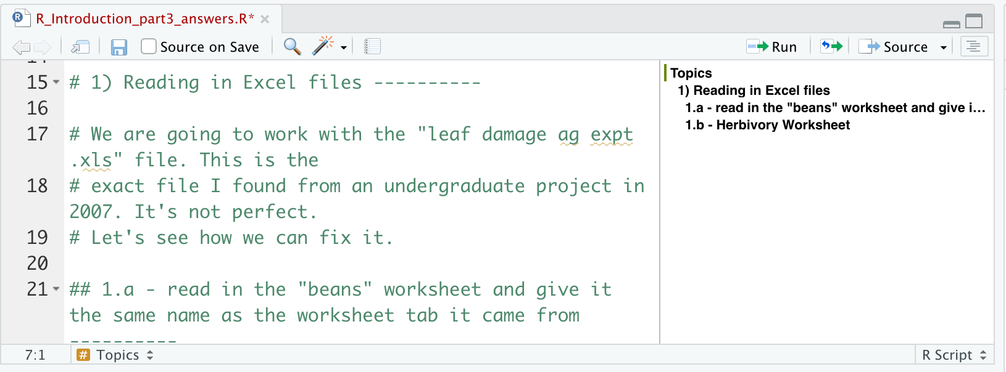
3. Styleguide - Outline
Use four or more dashes after a heading to indicate an outline item
# 1. Explore data -------------------
Add additional # signs to create subsections in outline
# 2. Run linear model --------------
## 2a. -------------
###2a.1 -------------

Slide 17
3. Styleguide - Syntax
Variable and function names should use CamelCase or all lowercase
Use underscores (_), aka snake case, to separate words within a name (not a period “.”)
Variable names should be nouns and function names should be verbs
Be concise when naming
Avoid re-using names of common functions and variables (e.g. don’t name any variables or functions “mean”)
Prefer TRUE and FALSE over T and F

Slide 18
3. Styleguide - spacing
Most operators (==, +, -, <-, etc.) should be surrounded by spaces.
Some very important operators (^, $, :) shouldn’t have a space
sqrt(x^2 + y^2)
df$z
x <- 1:10
Put spaces around ~ in double-sided formulas.
Response ~ predictor
Do not place a space before a comma, but always place one after a comma. lm(response ~ predictor, data = test)
Do not put spaces inside or outside parentheses for regular function calls
Adding extra spaces is ok if it improves alignment of = or <-

Slide 19
3. Code length
Strive to limit your code to 80 characters per line.
To add line at 80 characters, go to Preferences → Code → Display → Show margin column, margin column 80
If a function call is too long to fit on a single line, use one line each for the function name, each argument, and the closing ). This makes the code easier to read and to change later.

Slide 20
Wednesday
Read the paper by Hadley Wickham on tidy data
In class, we will write a data management plan and do an exercise to make a script more stylish

